Slide 1
Audio And Video Streaming Using Li-FI
VISIBLE LIGHT COMMUNICATION

Slide 2

Presented by M. S. PAVAN ADITYA(14981A0471) P. SIVA KRISHNA(14981A0470) P. HEMANTH KUMAR(14981A0494) B. SRAVAN KUMAR(15985A0407) Under the esteemed guidance of Dr. CH. SRINIVASU M. Tech, Ph. D Professor Department of ECE RAGHU ENGINEERING COLLEGE (A) Accredited by NAAC with a grade ‘A’ and Accredited by NBA DakamarRi, Bheemunipatnam (M), Visakhapatnam-531162 (2017-2018)

Slide 3
CONTENTS
ABSTRACT OF THE PROJECT
METHODOLOGY OF THE PROJECT
DATA COLLECTION AND EXPERIMENTAL SETUP
HARDWARE SETUP
SOFTWARE BLOCK DIAGRAM
DESCRIPTION OF THE ALGORITHM
RESULTS AND DISCUSSIONS
REFERENCES

Slide 4
ABSTRACT
Li-Fi is a label for wireless-communication systems using light as a carrier instead of traditional radio frequencies, as in Wi-Fi. The voice, speech, video data information can be transmitted using Li-Fi technology with high data rates. This technology is named as Li-Fi transmission which stands for Light Fidelity. This invention can produce data rates faster than 10 Mega-Bits per second which is much more than that of an average broadband speed of Wi-Fi connection and Bluetooth. Wireless communication has become a basic utility in personal and business life such that it becomes a fundamental of our lives, and this type of communication theory uses the radio spectrum which have limitations, i.e. capacity, efficiency, availability and security. The defects of Wi-Fi technology gave birth to the concept of Li-Fi technology. Li-Fi can be defined as a light-based Wi-Fi. This technology mainly serves the purpose of transmitting data using retrofitting of LED bulbs that has high efficiency, durability and reliability. With the increasing popularity of solid state lighting devices, Visible Light Communication (VLC) properly known Li-Fi technology is globally recognized as an advanced and promising technology to realize short-range, high speed as well as large capacity wireless data transmission. In this project, prototype of real-time audio and video broadcast system using inexpensive commercially available light emitting diode (LED) lamps is being implemented, and also with LED arrays is capable in supporting light illumination, data broadcast as well as video and audio streaming. Lighting model within room environment is designed and simulated, which indicates close relationship between layout of light sources and distribution of illuminance. Later, after the implementation of audio on the hardware setup is done, the video streaming is done using the MATLAB software for streaming it using the available LED block in Simulink. The final objective of Li-Fi development is the application of off-the-shelf LEDs in home environment wireless network to satisfy the needs of both illumination and data transmission.

Slide 5
Methodology of the Project
The current prevailing mode of transmission of data is Wi-Fi, it transmits data with a reputable speed but lacks in terms of security and safety
This problem can be resolved by implementing the transmission of data using visible light as medium
This proposed methodology is known as Li-Fi Communication
The proposed methodology consists of hardware and software setups
The hardware setup involves transmission of audio signals using hardware circuitry
The software setup involves transmission of video signals using MATLAB software

Slide 6
Data Collection and Experimental Setup
The data required for the experiment is the hardware components and the MATLAB software tool for working on the experiment
The experimental setup mainly consists of two parts,
Hardware Setup
Software Block diagram

Slide 7
Hardware Setup
The hardware setup mainly consists of transmitter and receiver circuits with LEDs and Solar Panel as their main parts
The transmitter circuit is constructed by connecting the input audio jack to a comparator circuit whose output is given to an LED driver circuit
The LED driver circuit drives the LEDs On and Off basing on the intensity of the voltage supplied to it
The LEDs modulate their intensity according to the voltage input and illuminate to emit the data in the form of visible light
At the receiver end, the solar panel detects the illuminated output of the transmitter LEDs and produces an Analog output waveform
This waveform is given to an amplifier circuit for amplification and removal of DC components if any
Finally, the amplified output is given to a speaker circuit which consists of an electromagnet which converts the Analog signal to audible sound

Slide 8
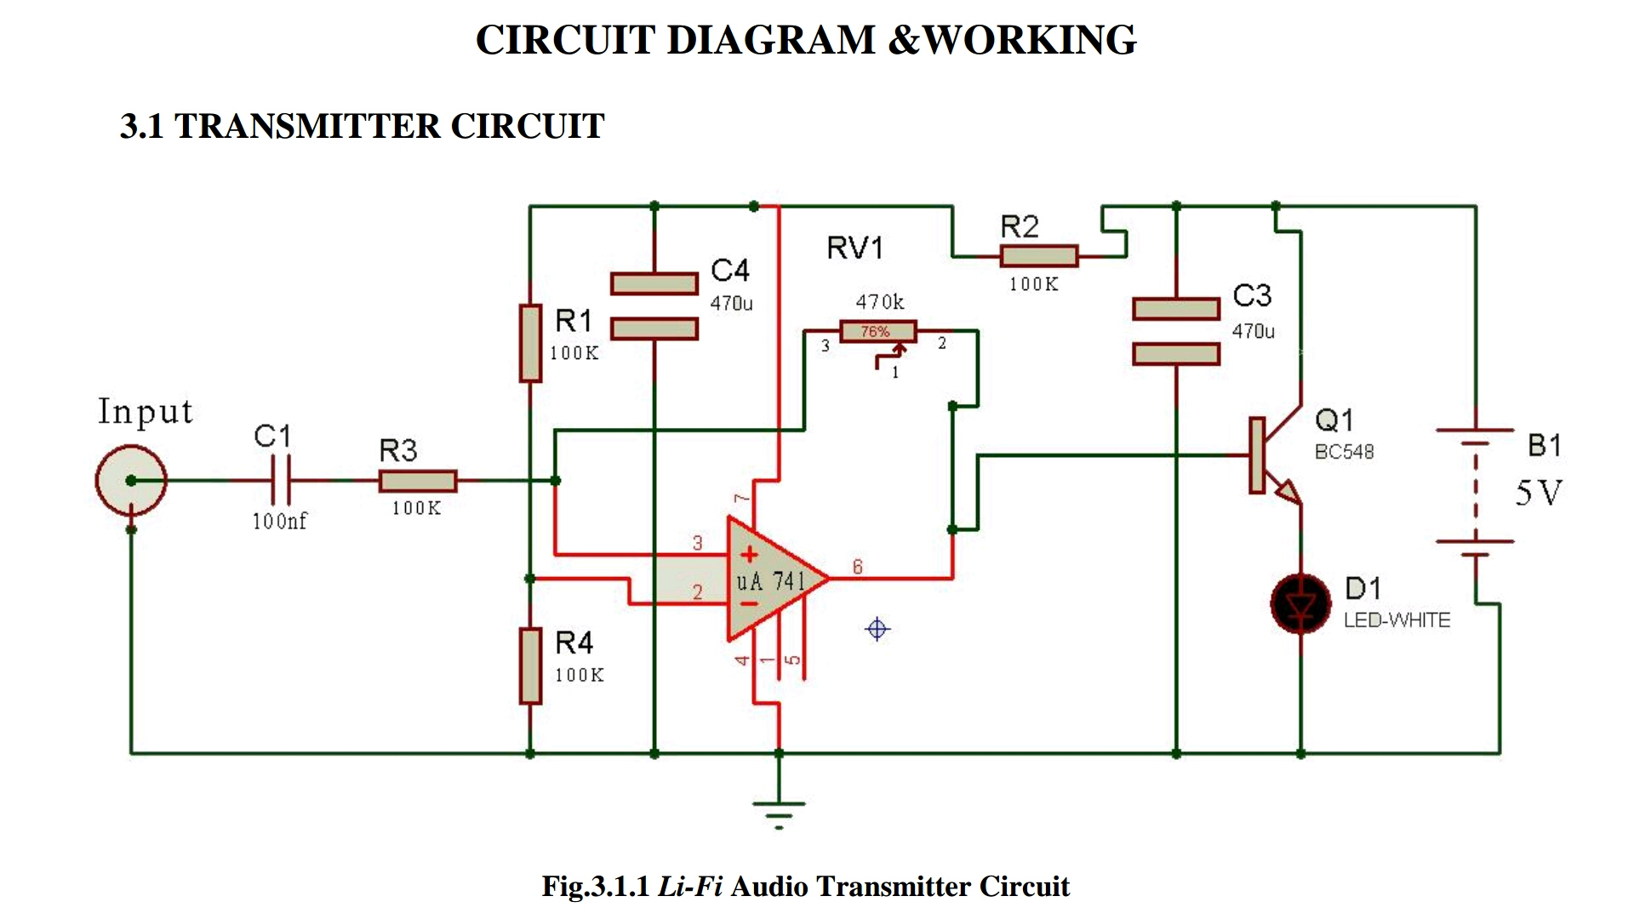
Transmitter circuit
LED BLUE

Slide 9
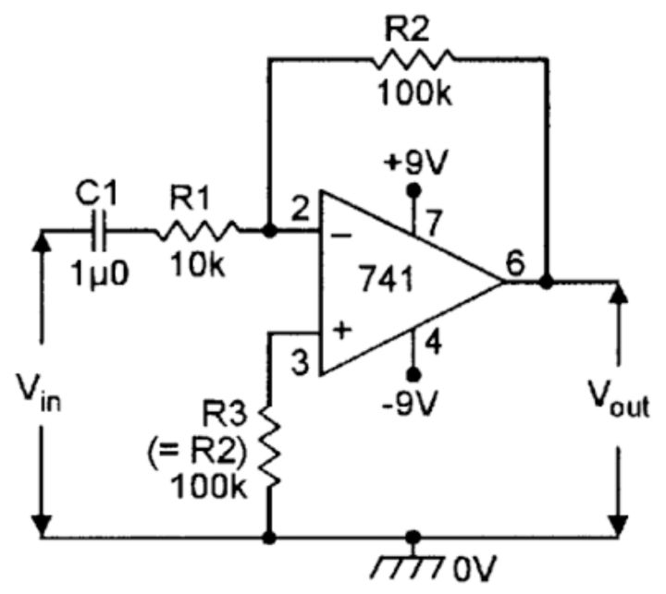

Receiver circuit
f

Slide 10
Software block diagram
Transmitter block
Video
Input
Video to
frames
RGB images to grayscale
LED
transmitter
Channel
Receiver block
Video
Output
Joining of frames
into video
Grayscale images
to RGB
Photodiode
Receiver

Slide 11
Algorithm
Step - 1: Read the Video file as an input to the video Input block
Step - 2: Determine the number of frames in the video and divide
them into their respective RGB images
Step - 3: Convert these RGB images into their respective grayscale
form by removing the colour components in them
Step - 4: Input these grayscale images to the LED block in Simulink
and modulate the LED according their pixel values
Step - 5: Receive the transmitted images through the photodiode
block.
Step - 6: Now convert the grayscale images back into their original
RGB form
Step - 7: Join all the RGB frames back to form the original video
Step - 8: Output the joined video and save it using MATLAB.

Slide 12
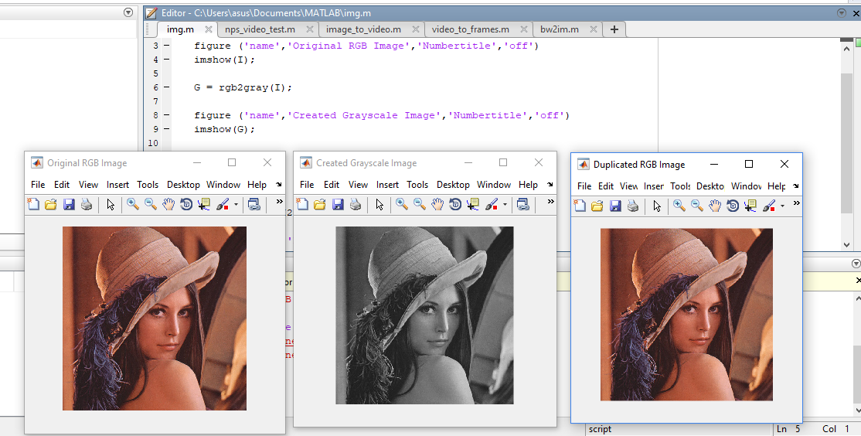
Conversion of RGB to grayscale

Slide 13
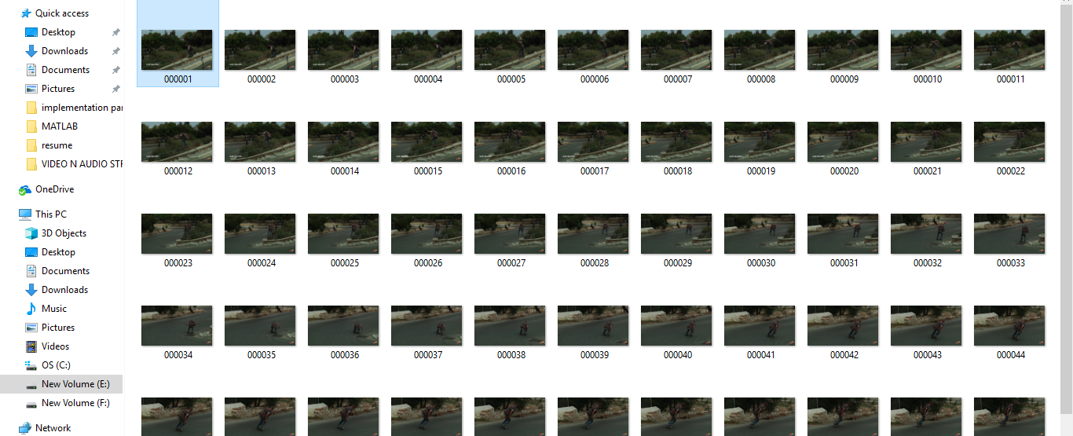
Video made into frames

Slide 14
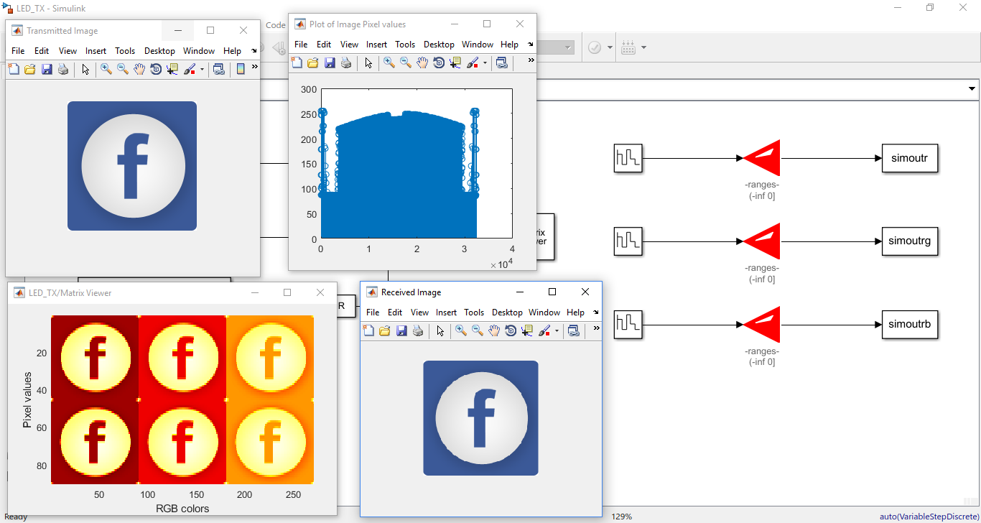
Transmission of Image through LEDs

Slide 15
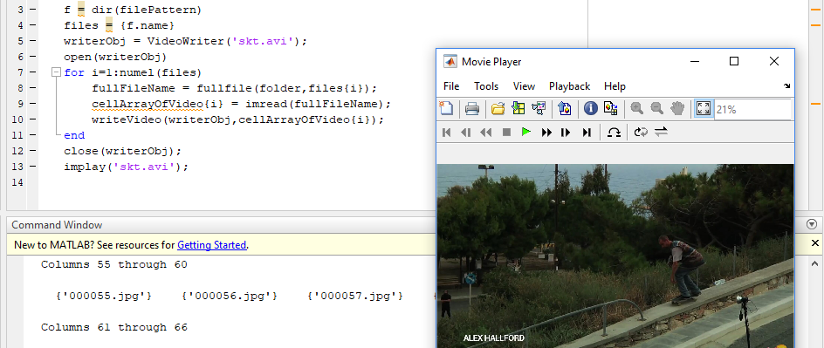
Video from joined frames

Slide 16
Results and Discussions
RESULTS
Implementation and Testing of the Hardware circuit on bread board is done in the hardware part
MATLAB Coding for the Video Input, Video to RGB frames, RGB to Grayscale blocks and Transmission of images through LEDs on the transmitter side and receiving the images, Grayscale to RGB, RGB frames to Video, Video Output blocks on the receiver side is done in the software part
DISCUSSIONS
The Hardware designing and making of the circuit on circuit board is to be done in the hardware part
MATLAB coding for the entire software algorithm is completed and implemented.

Slide 17
References
Optics and Photonics Journal, 2013, 3, 153-157 doi:10.4236/opj.2013.32B037 Published Online June 2013 “Li-Fi (Light Fidelity)-The future technology In Wireless communication?” by Jyoti Rani. “Journal from International Journal of Applied Engineering Research” (IJAER); ISSN 0973-4562 Vol.7 No.11 (2012)
TED Talk by Harald Hass on Li-Fi
Principles of LED Light Communications: Towards Networked Li-Fi by Svilen Dimitrov (Author),‎ Harald Haas (Author)
Li-Fi Technology for Indoor Access by Gado Moham (Author),‎ Abd El- Moghith Doaa (Author)
S. Dimitrov and H. Haas, ptimum Signal Shaping in OFDM-Based Optical Wireless Communication Systems, in Vehicular Technology Conference (VTC Fall), Sept 2012 IEEE.
International Journal for Trends in Engineering & Technology volume 23 issue 1 - May 2017 - ISSN: 2349 - 9303
Imperial Journal of Interdisciplinary Research (IJIR) Vol-2, Issue-6, 2016 ISSN: 2454-1362
T. D. C. Little, P. Dib, K. Shah, N. Barra Ford and B. Gallagher, “Using LED Lighting for Ubiquitous Indoor Wireless Networking,” IEEE International Conference on Wireless and Mobile Computing, pp. 373-378, 2008. doi:10.1109/WiMob.2008.57
Wirelessly Transmitting a Grayscale Image using Visible Light from International Journal of Computer Applications (0975 – 8887) Volume 58– No.14, November 2012
Ian Lim, Li-Fi Internet at the Speed of Light, the gadgeteer, 29 August 2011

Slide 18
THANK YOU

